Slide 1


YOUR LOGO
CISC3003 Work Report
Campus Q&A
TEAM 04
Pair 06
Huang Yanzhen, DC126732
Li Ruoxuan, DC027534
Pair 04
Chen Zirui, DC127901
Guo Pengze, DC127461
Pair 24
Chen Pengyu, DC125135
Lei Chon Hin, DC026736
Web programming

Slide 2
Introduction
In the University of Macau, there has never been a unified school forum.
Therefore, we hope to develop a student forum software, so that
everyone can freely raise and discuss their questions in study and life and
get answers from enthusiastic students.
Function：Campus Q&A is a platform that allows students on campus to ask and answer questions. A student can post a public question for all students to answer, and a student can answer a public question by replying to the corresponding public post.
Target User：campus students
Technologies： Front-end: HTML + CSS + JS Back-end: PHP + MySQL

Slide 3
Introduction / User Stories
As a student, I want to post a question so that I can ask the public about what I'm confused about.
As a student, I want to view the replies to my posts so that I can compare other's answers.
As a student, I want to reply to other's posts so that I can answer the question asker about what he or she is confused about.

Slide 4
PART 01
Development Workflow

Slide 5
Development Workflow / Source Control
Git
Record changes from multiple members and resolve conflicts
Store different versions: Stable, Development, etc.
Synchronizing Workflows
Multiple-Platform Testing: Windows and MacOS

Slide 6
Development Workflow / Development Branches
modifyCardView
PAIR 04
Retrieve posts from db
master
dev
login
PAIR 06
Stable version
Development Incrementals
Manage Cookies
Risk Level
 | High
 | Medium
 | Low
profile Details
PAIR 24
Retrieve replies from db

Slide 7
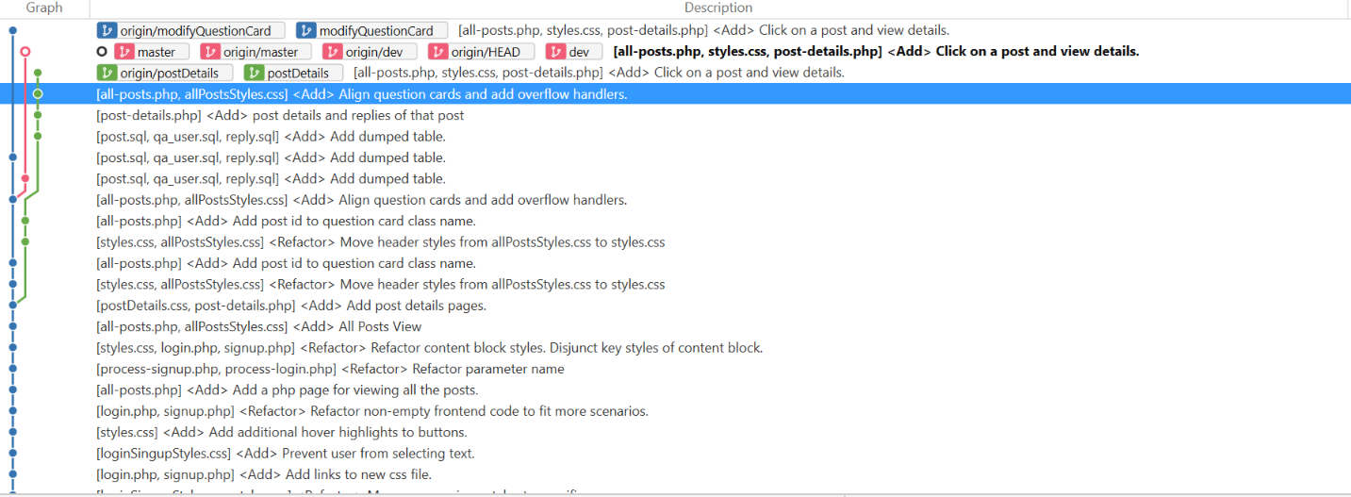
Development Workflow / Commits Preview

Slide 8
PART 02
Database Design

Slide 9
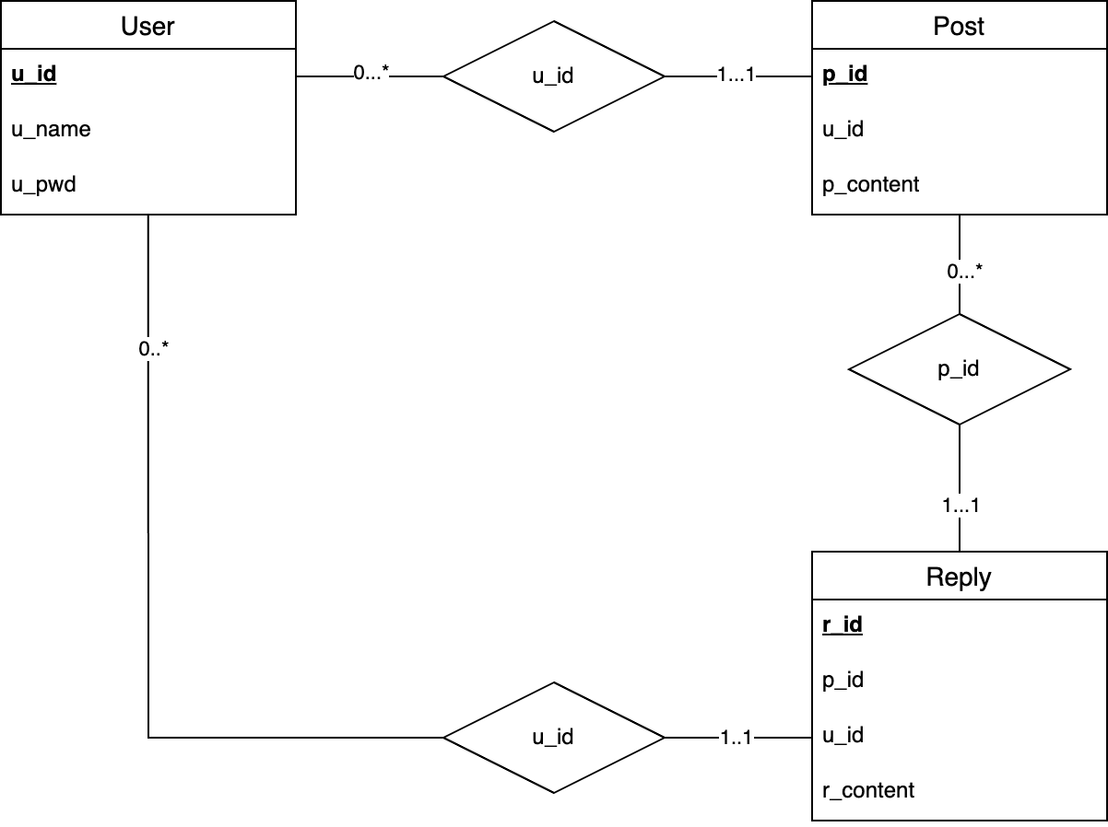
Database Design / Entity-Relation Diagram
User-Post: One to Many.
Post-Reply: One to Many.
User-Reply: One to Many.

Slide 10
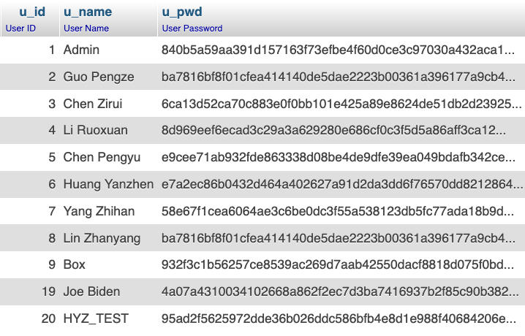
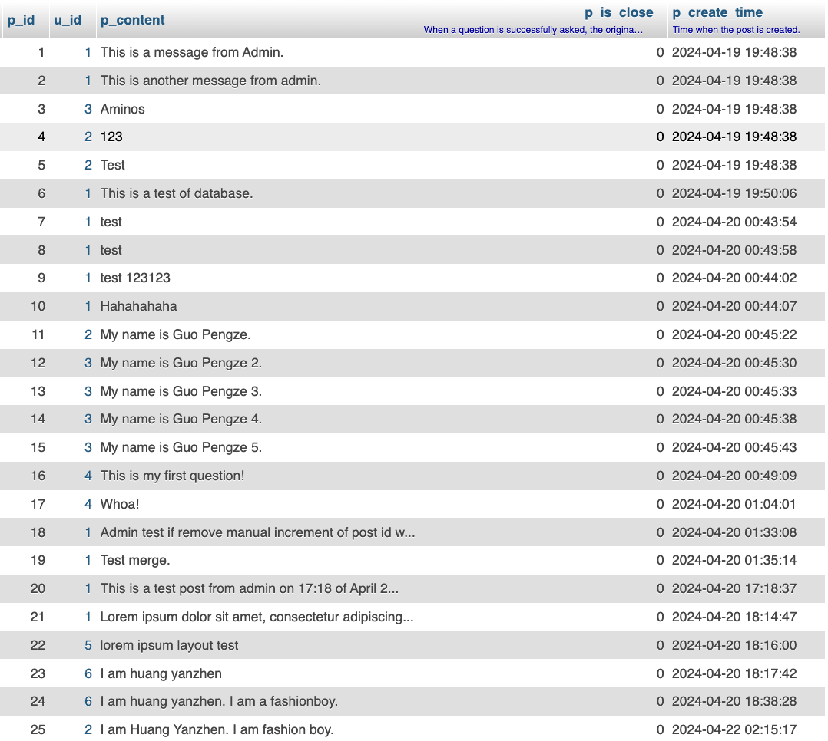
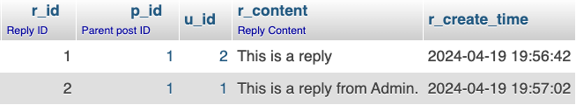
Database Design / Tables
qa_user
post
reply

Slide 11
PART 03
Front End Design

Slide 12

Frontend Design
As our goal is to create a Q&A website that can cover both learning
and life problems, a discussion chart is adopted as the background
of the website, indicating that students can actively discuss and communicate
on this website to solve their own life problems. The color scheme of
the background in tong time adopts red and blue colors to highlight the
contrast and respectively represent the questions and answers
标题二
1/4

Slide 13
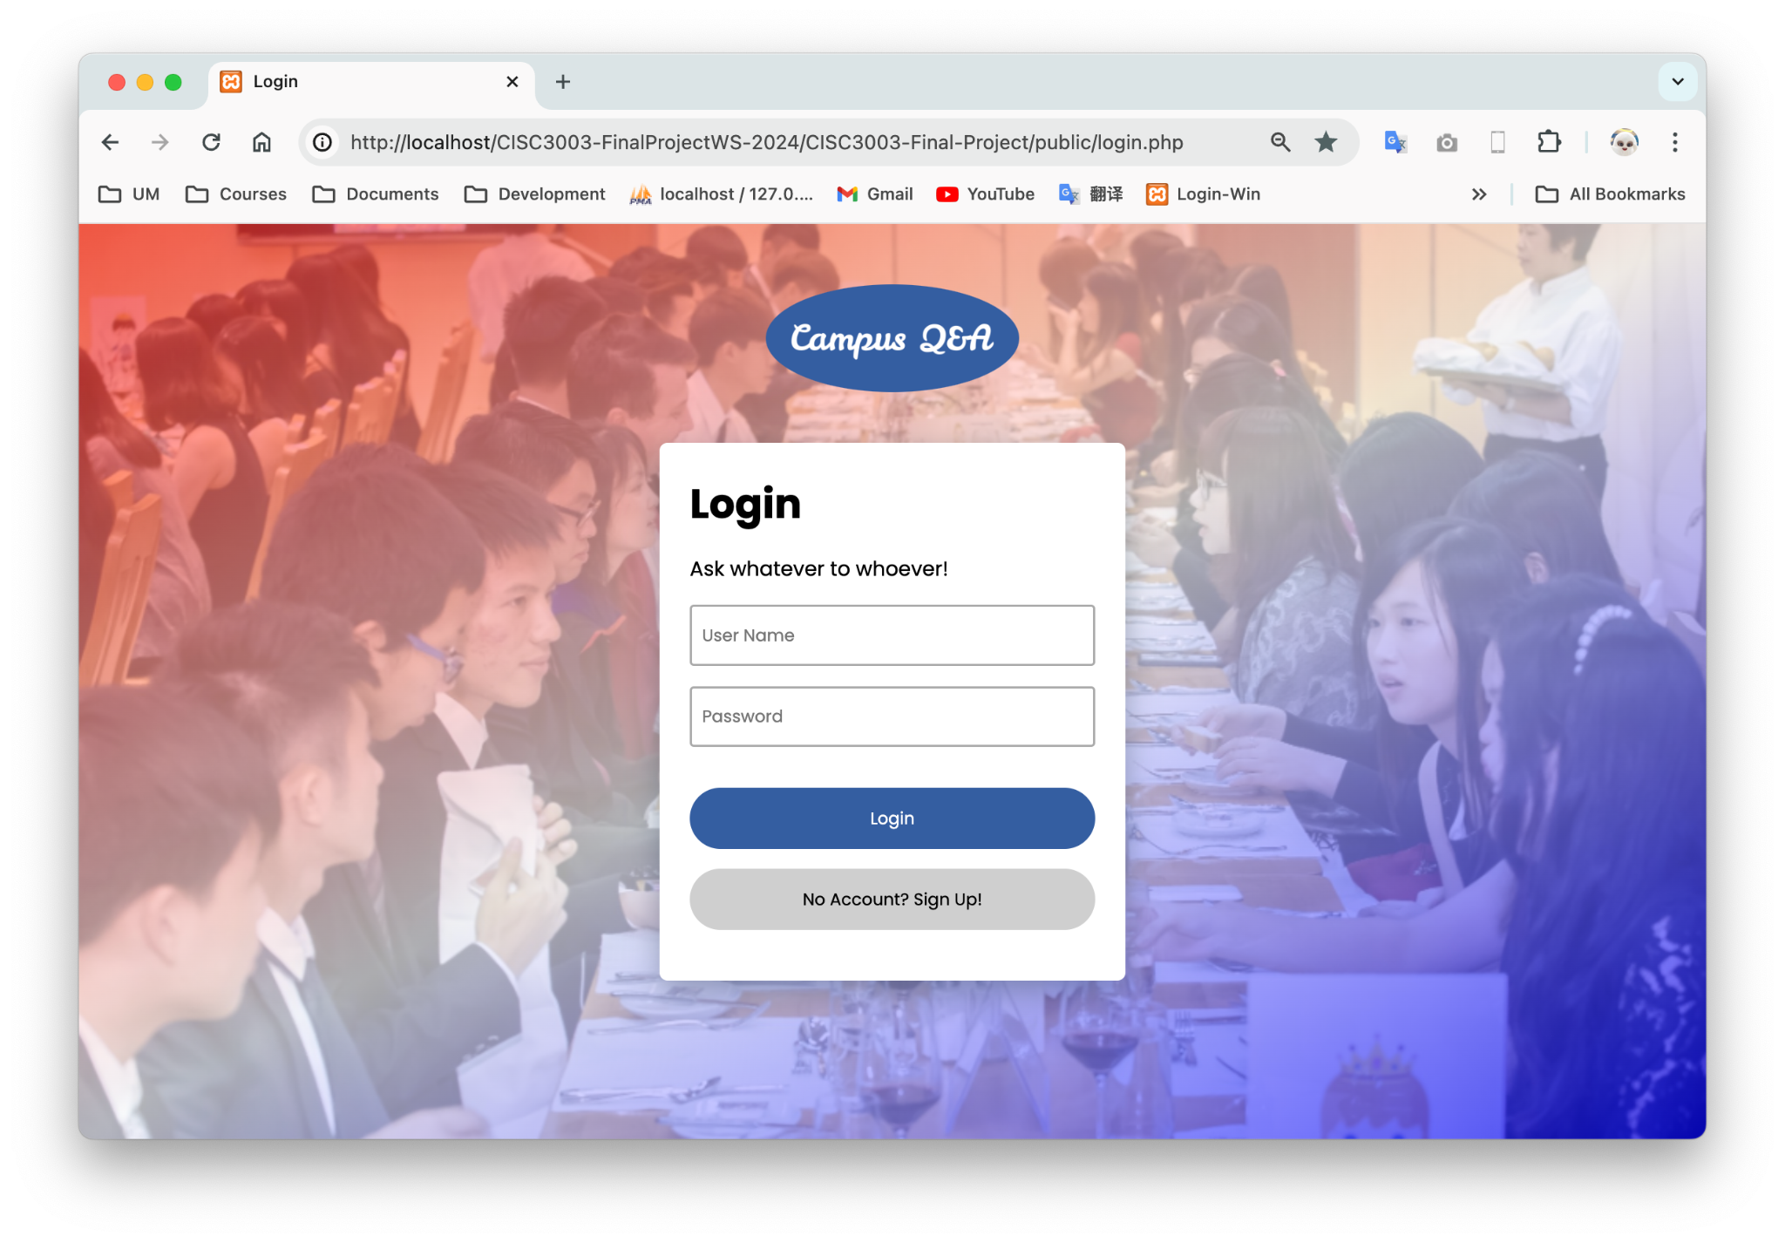
Frontend Design：Login page
Logo
Login Panel
Input Fields
标题二
Primary & Secondary Buttons

Slide 14
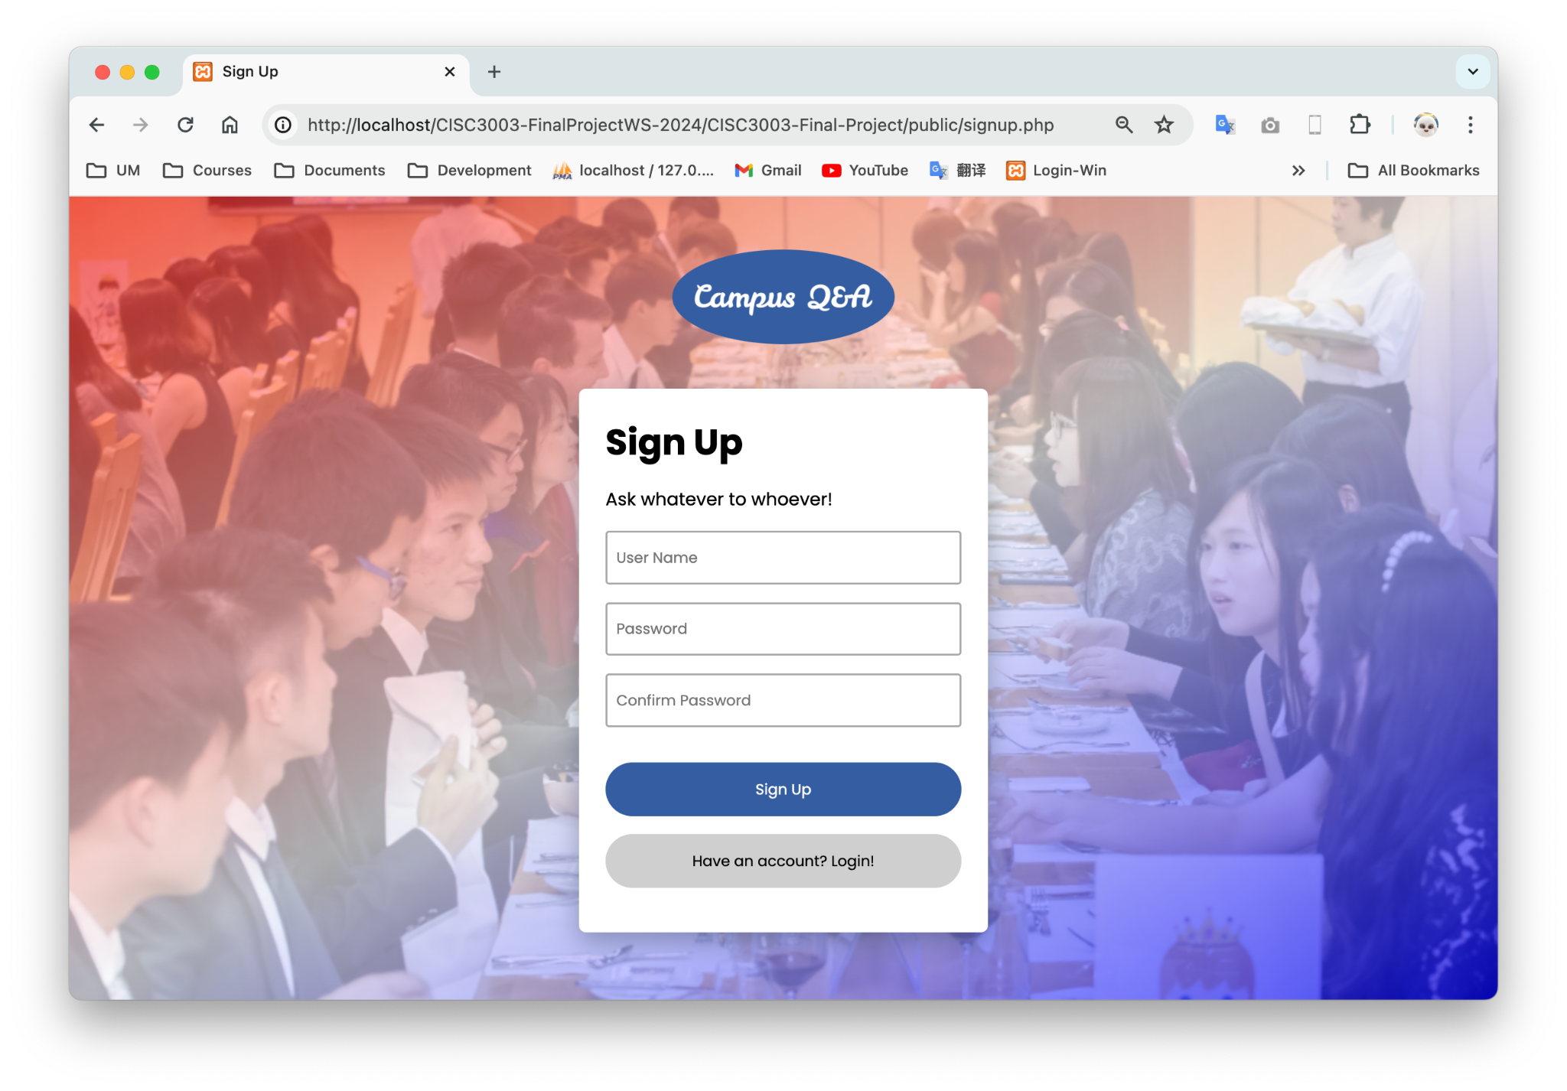
Frontend Design：Sign Up page
Logo
Sigg Up Panel
Input Fields
Primary & Secondary Buttons

Slide 15
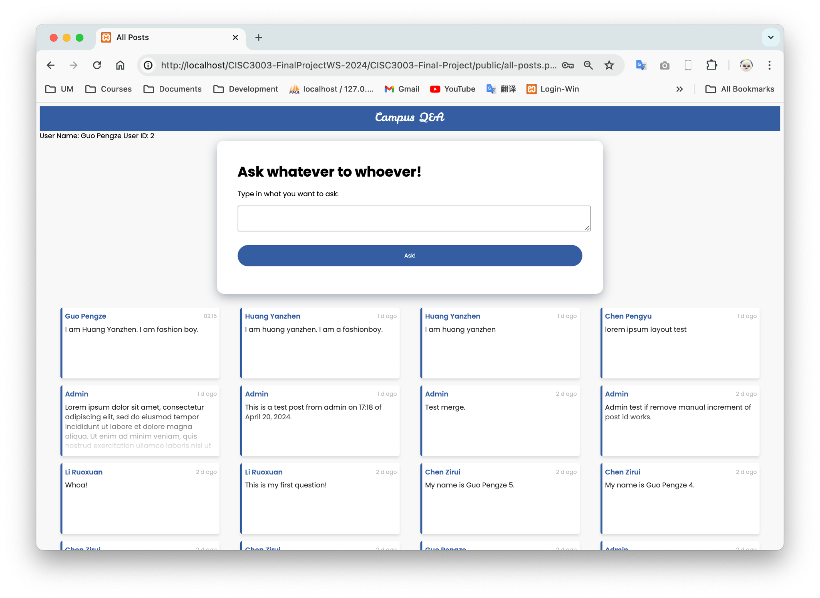
Frontend Design：All-Posts Page

Slide 16
PART 04
Demo

Slide 17
Thank you for listening!

